Slide 1
Lesson 3: Variables
Variables are variable. Why they are called Variables
Ben Schwarz

Slide 2
What is a variable
Computers operate a little bit like people. They do things. But, in order to do useful things, they also need to remember things. Variables are computers ways to remember things. Imagine a big storing wall. The wall has lots of boxes, all labelled. When you have an object, you can go store it in a certain box. Later you can go get the object back out of the box.
Each box is like a variable. Each variable has a name, and you address it by it's name. You can store values in variables, and retrieve and do things with that value.
Analogy copied inspired from Tom Schwarz

Slide 3
Explanatory/Technical Stuff
The thing stored in a variable is a value. It changes, what makes a variable, variable. HAHAHA. This is the variable.
The name attached to it is the variable name. The difference between the variable name and the variable is that the variable refers to all memory which stores the value, it’s type and the variable itself while the variable name is some text which refers to the variable. If you think this distinction is to subtle for you, don’t worry – join the club.

Slide 4
Variable Type (Data Types)
You know the tv where you fly around the circuits in a computer and they show 0s (zeros) and 1s (ones) sailing by. Well this is because this what a computer deals with.
When you think the computer is storing the letter j, it’s actually storing 01001010* (May not be).
This sequence can also stand for the number 74, 1.036960863003646x10⁻⁴³ or interpreted as screen pixels. This sequence can stand for whatever the computer interprets it to be.
So, how do you tell the computer what it stands for, the answer is type. The type of a variable is the range of values that the variable is permitted to store.
If you are here from Sean’s workshops you would know these are data types.

Slide 5
Making Variables
Three parts to a variable:
The type of the variable (The data type)
The name of the variable
The value of the variable
Convention for variable names is to be lowerCamelCase - start of each word capitalized, except for the first word.
Java is a strongly typed language. This means that every variable has a type which can't be changed. Other (hipster) languages like Python aren't strongly typed - anything can go in any variable at any time. But this means you have to be very careful with what you're doing.

Slide 6
Common Data Types
Type (Case Sensitive) | Description | Examples
int | Stores an integer. | 1, -5, 304, 9893
double | Stores numbers with a decimal point | 1.0, 25.493, -322.44
boolean | Stores a true or false value | true, false,
String | Stores a sequence of characters inside of “”. For Strings you need to use a capital S. | “Hello World”, “Bork!”, “We are number one”

Slide 7
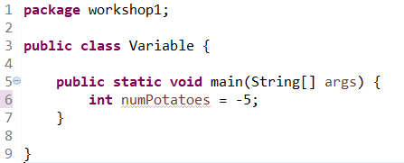
Now lets make a variable
Open your pre-existing class, or make a new one.
Type in the variable type. We will use int.
Give it a name. For e.g. ‘numPotatoes’.
Add an equal sign and then set a value. Remember a semi-colon to finish the line.
Should look something like this:

Slide 8
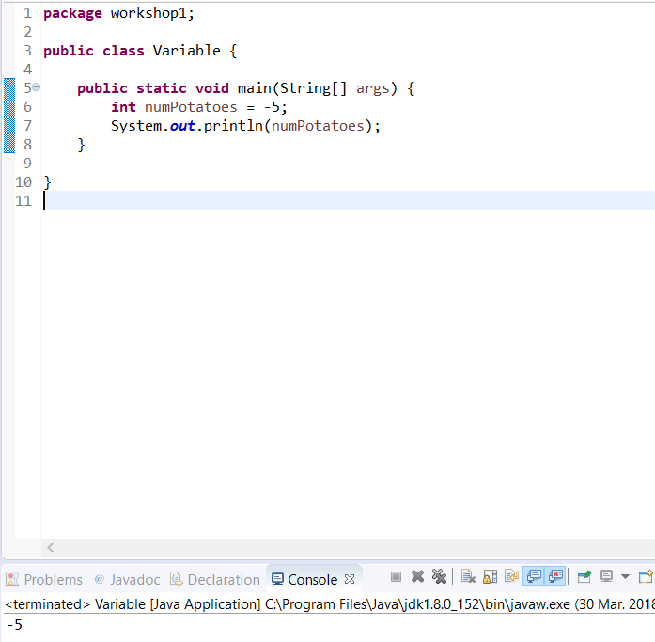
Accessing Variables
Easy to do. Just type the variable name, no need to mention the type – since it can’t change. (Actually, you shouldn’t use the type anyway)
Looks like this:

Slide 9
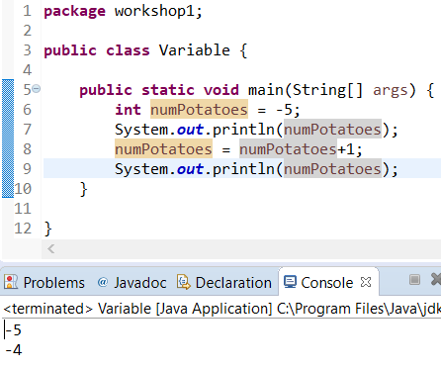
Changing Variable Values
Write the variable name
Add =
Write new value (THIS DELETES OLD VALUE)
You can even reference the variables current value when setting a new value. Simply access the variable the same way we did before.
Should look like this:

Slide 10
Lazy Tips and tricks
Often you will want to do certain things to a variable. Since we programmers are lazy, we have special Syntax to do these things quickly.
Table of Useful Shortcuts (Not all of them):
Operator | Description
+= | Add amount to variable
-= | Subtract amount to variable
*= | Times variable by amount
/= | Divide variable
%= | Modulus operator. Divides variable by a number, and sets variable to the remainder. (E.g. 10 % 3 = 1)
++ | Add one to a variable (e.g aNumber++;)
-- | Subtract one to a variable(e.g. aNumber--;)

Slide 11
Activities:
Print out different variables. Try int, double, boolean and String.
Add and subtract various variables. Throw in some brackets. Does it follow BODMAS?
Can you add strings together?
Can you add strings and numbers together?
for two given side lengths, output the hypotenuse (You will need to google to find out how to get the square root of a number)
What is the maximum size an int can be?
Print out the sum of two floats. (hint: sum two numbers that aren't powers of 2)

